Slide 1
CSE214 – Analysis of Algorithms PhD Furkan Gözükara, Toros University https://github.com/FurkanGozukara/Analysis-of-Algorithms-2019
Lecture 2
Asymptotic Notation
Based on Cevdet Aykanat’s and Mustafa Ozdal’s Lecture Notes - Bilkent

Slide 2
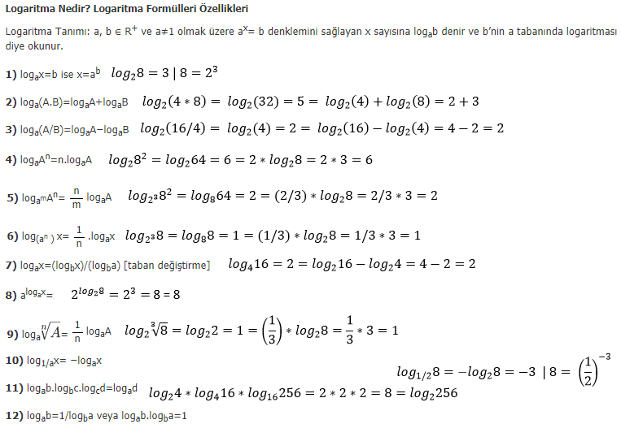

Slide 3
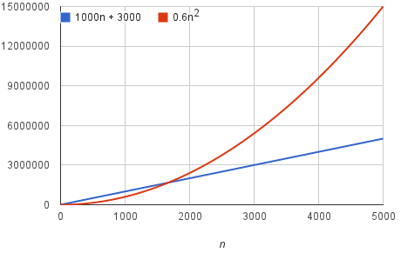
What is Asymptotic notation
By dropping the less significant terms and the constant coefficients, we can focus on the important part of an algorithm's running time—its rate of growth—without getting mired in details that complicate our understanding.
When we drop the constant coefficients and the less significant terms, we use asymptotic notation.
We'll see three forms of it: big-Theta Θ notation, big-O notation, and big-Omega Ω notation.
Notes:
Mire batak çamura saplanmak

Slide 4
O-notation: Asymptotic upper bound
f(n) = O(g(n)) if ∃ positive constants c, n₀ such that
0 ≤ f(n) ≤ cg(n), ∀n ≥ n₀
cg(n)
Asymptotic running times of algorithms are usually defined by functions whose domain are N={0, 1, 2, …} (natural numbers)
f(n) = O(g(n))
f(n)
n₀
n
Notes:
Big o notasyonu , üst sınır

Slide 5
Example
Show that 2n² = O(n³)
We need to find two positive constants: c and n₀ such that:
0 ≤ 2n² ≤ cn³ for all n ≥ n₀
Choose c = 2 and n₀ = 1
➔ 2n² ≤ 2n³ for all n ≥ 1
Or, choose c = 1 and n₀ = 2
➔ 2n² ≤ n³ for all n ≥ 2

Slide 6
Example
Show that 2n² + n = O(n²)
We need to find two positive constants: c and n₀ such that: 0 ≤ 2n² + n ≤ cn² for all n ≥ n₀
2 + (1/n) ≤ c for all n ≥ n₀
Choose c = 3 and n₀ = 1
➔ 2n² + n ≤ 3n² for all n ≥ 1

Slide 7
O-notation
What does f(n) = O(g(n)) really mean?
The notation is a little sloppy
One-way equation
e.g. n² = O (n³), but we cannot say O(n³) = n²
O(g(n)) is in fact a set of functions:
O(g(n)) = {f(n): ∃ positive constants c, n₀ such that
0 ≤ f(n) ≤ cg(n), ∀n ≥ n₀}
Notes:
Sloppy özensiz

Slide 8
O-notation
O(g(n)) = {f(n): ∃ positive constants c, n₀ such that
0 ≤ f(n) ≤ cg(n), ∀n ≥ n₀}
In other words: O(g(n)) is in fact:
the set of functions that have asymptotic upper bound g(n)
e.g. 2n² = O(n³) means 2n² ∈ O(n³)
2n² is in the set of functions that have asymptotic upper bound n³

Slide 9

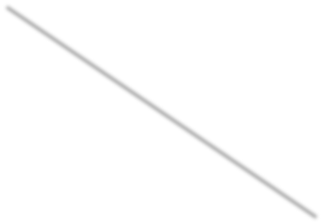
True or False?
Choose c = 10⁹ and n₀ = 1 0 ≤ 10⁹n² ≤ 10⁹n² for n ≥1
Choose c = 100 and n₀ = 1
10⁹n² = O (n²)
True
100n^{1.9999} = O (n²)
True
_{0 ≤ 100n}1.9999
≤ 100n² for n≥1
10⁻⁹n^{2.0001} ≤ cn² for n ≥ n₀
10⁻⁹ n^{0.0001} ≤ c for n ≥ n₀
Contradiction
₁₀-9_{n}2.0001 _{= O (n}2₎
False

Slide 10
Summary: O-notation: Asymptotic upper bound
f(n) ∈ O(g(n)) if ∃ positive constants c, n₀ such that
0 ≤ f(n) ≤ cg(n), ∀n ≥ n₀
cg(n)
f(n) = O(g(n))
f(n)
n₀
n
Notes:
Reverse E means there exists

Slide 11
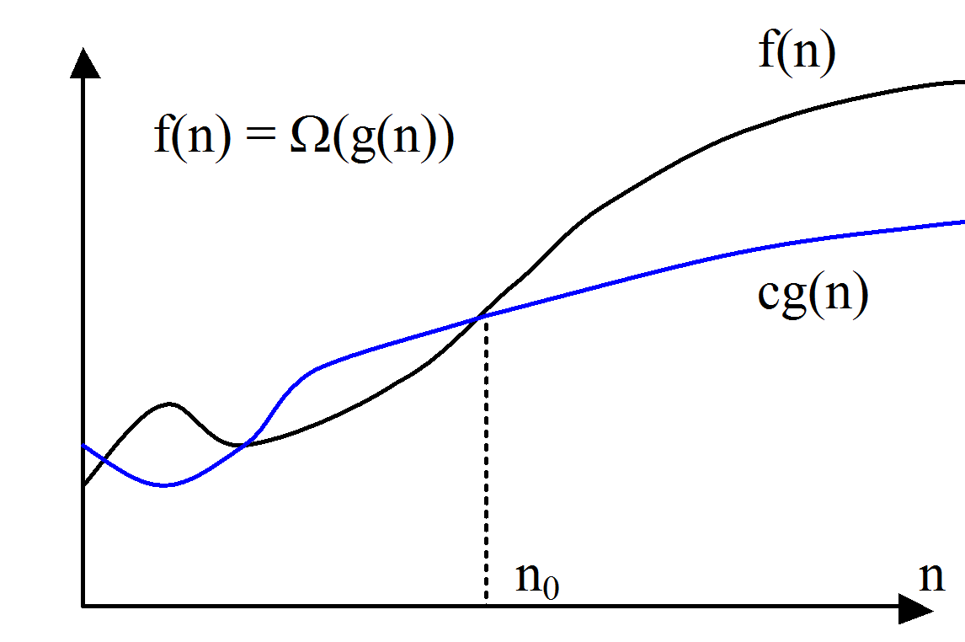
Ω-notation: Asymptotic lower bound
f(n) = Ω (g(n)) if ∃ positive constants c, n₀ such that
0 ≤ cg(n) ≤ f(n), ∀n ≥ n₀
Ω: “big Omega”

Slide 12
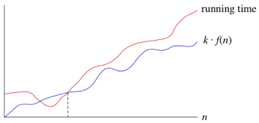
What is Asymptotic lower bound
If a running time is Ω(f(n)), then for large enough n, the running time is at least k⋅f(n), for some constant k. Here's how to think of a running time that is Ω(f(n)):
Sometimes, we want to say that an algorithm takes at least a certain amount of time, without providing an upper bound. We use big-Ω notation; that's the Greek letter "omega."
We say that the running time is "big-Ω of f(n)" We use big-Ω notation for asymptotic lower bounds, since it bounds the growth of the running time from below for large enough input sizes.

Slide 13
Example
Show that 2n³ = Ω(n²)
We need to find two positive constants: c and n₀ such that: 0 ≤ cn² ≤ 2n³ for all n ≥ n₀
Choose c = 1 and n₀ = 1
➔ n² ≤ 2n³ for all n ≥ 1

Slide 14

Example
Show that = Ω(lg n)
We need to find two positive constants: c and n₀ such that:
c lg n ≤ for all n ≥ n₀
Choose c = 1 and n₀ = 16
➔ lg n ≤
for all n ≥ 16

Slide 15
Ω-notation: Asymptotic Lower Bound
Ω(g(n)) = {f(n): ∃ positive constants c, n₀ such that
0 ≤ cg(n) ≤ f(n), ∀n ≥ n₀}
In other words: Ω (g(n)) is in fact:
the set of functions that have asymptotic lower bound g(n)

Slide 16
True or False?
Choose c = 10⁹ and n₀ = 1 0 ≤ 10⁹n² ≤ 10⁹n² for n ≥1
10⁹n² = Ω (n²)
True
_{≤ 100n}1.9999
_{100n}1.9999 _{= Ω}
(n²)
cn² for n ≥ n₀
False
n^{0.0001} ≤ (100/c) for n≥n
Contradiction
0
Choose c = 10⁻⁹ and n₀ =1
0 ≤ 10⁻⁹n² ≤ 10⁻⁹n^{2.0001} for n ≥1
₁₀-9_{n}2.0001 _{= Ω (n}2₎
True

Slide 17
Summary: O-notation and Ω-notation
O(g(n)): The set of functions with asymptotic upper bound g(n)
f(n) = O(g(n))
f(n) ∈ O(g(n)) if ∃ positive constants c, n₀ such
that
0 ≤ f(n) ≤ cg(n), ∀ n ≥ n₀
Ω(g(n)): The set of functions with asymptotic lower bound g(n)
f(n) = Ω(g(n))
f(n) ∈ Ω(g(n)) ∃ positive constants c, n₀ such that
0 ≤ cg(n) ≤ f(n), ∀n ≥ n₀

Slide 18
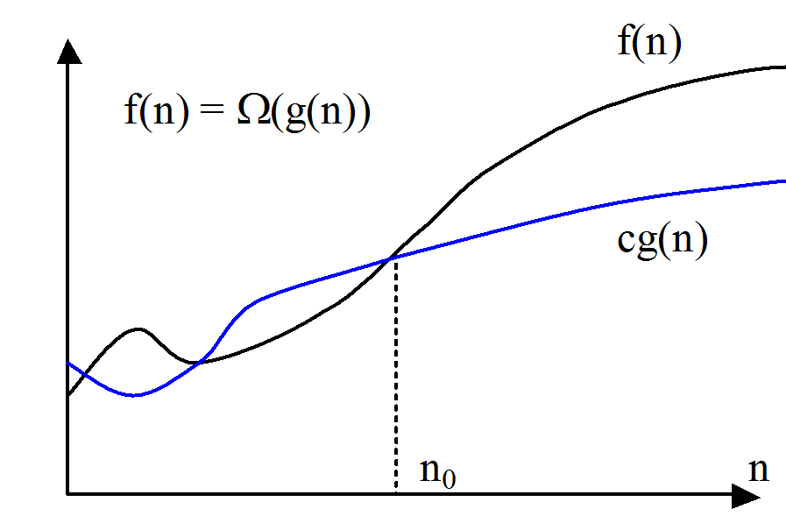
Summary: O-notation and Ω-notation
cg(n)
f(n) = O(g(n))
f(n)
n₀
n

Slide 19
Θ-notation: Asymptotically tight bound
f(n)=Θ(g(n)) if ∃ positive constants c₁, c₂, n₀ such that
0 ≤ c₁g(n) ≤ f(n) ≤ c₂g(n), ∀n ≥ n₀
c₂g(n)
f(n)
c₁g(n)
n₀
n

Slide 20
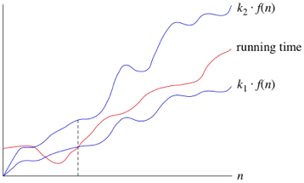
What is Asymptotically tight bound
When we say that a particular running time is Θ(n), we're saying that once n gets large enough, the running time is at least k1​⋅f(n) and at most k2​⋅f(n) for some constants k1​ and k2​. Here's how to think of Θ(n):
Once n gets large enough, the running time is between k1​⋅f(n) and k2​⋅f(n)

Slide 21
Example
Show that 2n² + n = Θ(n²)
We need to find 3 positive constants: c₁, c₂ and n₀ such that: 0 ≤ c₁n² ≤ 2n² + n ≤ c₂n² for all n ≥ n₀
c₁ ≤ 2 + (1/n) ≤ c₂ for all n ≥ n₀
Choose c₁ = 2, c₂ = 3, and n₀ = 1
➔ 2n² ≤ 2n² + n ≤ 3n² for all n ≥ 1

Slide 22
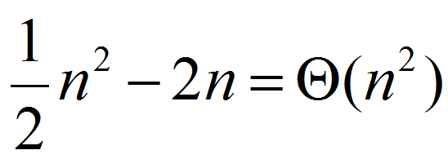
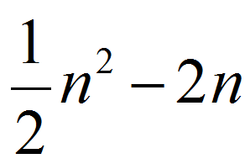
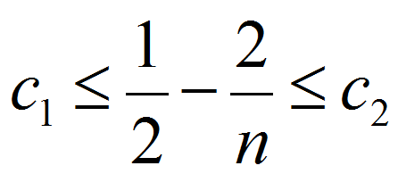
Example
Show that
We need to find 3 positive constants: c₁, c₂ and n₀ such that: 0 ≤ c₁n² ≤ ≤ c₂n² for all n ≥
n₀
for all n ≥ n₀

Slide 23
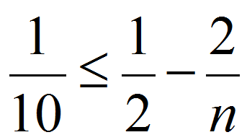
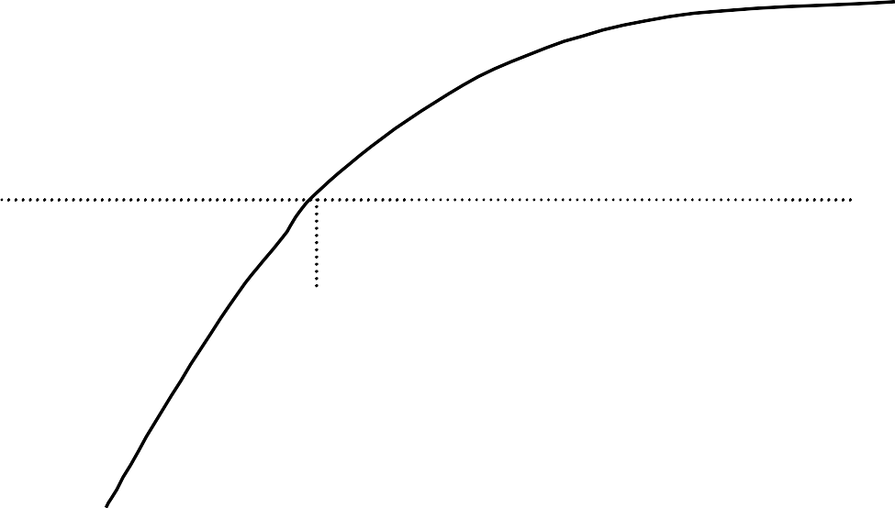
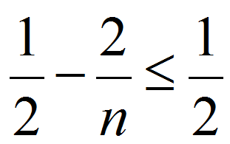
Example (cont’d)
Choose 3 positive constants: c₁, c₂, n₀ that satisfy:
for all n ≥ n₀
h(n) =1/2-2/n
1/2
for n ≥ 5
1/10
1 2 3 4 5
(n₀)
n
for n ≥ 0

Slide 24
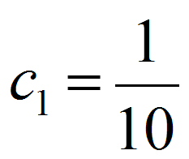
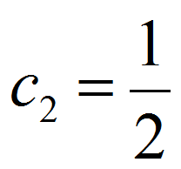
Example (cont’d)
Choose 3 constants: c₁, c₂, n₀ that satisfy:
for all n ≥ n₀
for n ≥ 5
for n ≥ 0
Therefore, we can choose::
n₀ = 5

Slide 25
Θ-notation: Asymptotically tight bound
Theorem: leading constants & low-order terms don’t matter
Justification: can choose the leading constant large enough to make high-order term dominate other terms

Slide 26
True or False?
10⁹n² = Θ (n²)
True
100n^{1.9999} = Θ (n²)
False
₁₀-9_{n}2.0001 _{= Θ (n}2₎
False

Slide 27
Θ-notation: Asymptotically tight bound
Θ(g(n))={f(n): ∃ positive constants c₁, c₂, n₀ such that
0 ≤ c₁g(n) ≤ f(n) ≤ c₂g(n), ∀n ≥ n₀}
In other words: Θ(g(n)) is in fact:
the set of functions that have asymptotically tight bound g(n)

Slide 28
Θ-notation: Asymptotically tight bound
Theorem:
f(n) = Θ(g(n)) if and only if
f(n) = O(g(n)) and f(n) = Ω(g(n))
In other words:
Θ is stronger than both O and Ω
Notes:
Αλτ κυμεσι

Slide 29
Example
Prove that 10⁻⁸ n² ≠ Θ(n)
Before proof, note that 10⁻⁸n² = Ω (n) but 10⁻⁸n² ≠ O(n)
Proof by contradiction:
Suppose positive constants c₂ and n₀ exist such that:
10⁻⁸n² ≤ c₂n
10⁻⁸n ≤ c₂
for all n ≥ n₀
for all n ≥ n₀
Contradiction: c₂ is a constant

Slide 30
Summary: O, Ω, and Θ notations
O(g(n)): The set of functions with asymptotic upper bound g(n)
Ω(g(n)): The set of functions with asymptotic lower bound g(n)
Θ(g(n)): The set of functions with asymptotically tight bound g(n)
f(n) = Θ(g(n)) if and only if f(n) = O(g(n)) and f(n) = Ω(g(n))

Slide 31

Summary: O, Ω, and Θ notations
cg(n)
f(n) = O(g(n))
f(n)
n₀
n
f(n) = Θ(g(n))
c₂g(n)
f(n)
c₁g(n)
n₀
n

Slide 32

o (“small o”) Notation Asymptotic upper bound that is not tight
Reminder: Upper bound provided by O (“big O”) notation can be tight or not tight:
e.g.
2n² = O(n²)
2n = O(n²)
is asymptotically tight
is not asymptotically tight
both true
o-Notation: An upper bound that is not asymptotically tight

Slide 33
o (“small o”) Notation Asymptotic upper bound that is not tight
o(g(n)) = {f(n): for any constant c > 0,
∃ a constant n₀ > 0, such that 0 ≤ f(n) < cg(n), ∀n ≥ n₀}
lim ^{f (n)} = 0
Intuitively:
^{n→∞} g(n)
e.g., 2n = o(n²),
but 2n² ≠ o(n²),
any positive c satisfies
c = 2 does not satisfy

Slide 34
ω (“small omega”) Notation Asymptotic lower bound that is not tight
ω(g(n)) = {f(n): for any constant c > 0,
∃ a constant n₀ > 0, such that
0 ≤ cg(n) < f(n), ∀n ≥ n₀}
lim ^{f (n)} = ∞
Intuitively:
^{n→∞} g(n)
e.g., n²/2 = ω(n),
but n²/2 ≠ ω(n²),
any positive c satisfies
c = 1/2 does not satisfy

Slide 35
Analogy to the comparison of two real numbers
f(n) = O(g(n)) ↔ a ≤ b
f(n) = Ω(g(n)) ↔ a ≥ b
f(n) = Θ(g(n)) ↔ a = b
f(n) = o(g(n)) ↔ a < b
f(n) = ω(g(n)) ↔ a > b
Notes:
<-> eşittir demek

Slide 36
True or False?
5n² = O(n²)
5n² = Ω(n²)
5n² = Θ(n²) 5n² = o(n²)
5n² = ω(n²)
True True True
False False
n²lgn = O(n²) n²lgn = Ω(n²) n²lgn = Θ(n²) n²lgn = o(n²) n²lgn = ω(n²)
False True False
False True
2^{n} = O(3^{n})
2^{n} = Ω(3^{n})
2^{n} = Θ(3^{n})
True
False False
2^{n} = o(3^{n}) 2^{n} = ω(3^{n})
True
False
Notes:
Bunu sorarım sınavda

Slide 37
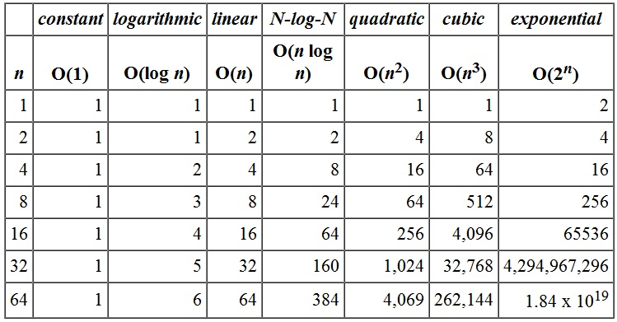
Asymptotic Growth Rates Comparison

Slide 38
Using O-Notation to Describe Running Times
Used to bound worst-case running times
◉ Implies an upper bound runtime for arbitrary inputs as well
Example:
“Insertion sort has worst-case runtime of O(n²)”
Note: This O(n²) upper bound also applies to its running time on every input.
Notes:
Arbitrary keyfi , isteğe bağlı olmayan , rastlantısal

Slide 39
Using O-Notation to Describe Running Times
Abuse to say “running time of insertion sort is O(n²)”
For a given n, the actual running time depends on the particular input of size n
◉ i.e., running time is not only a function of n
However, worst-case running time is only a function of n

Slide 40
Using O-Notation to Describe Running Times
When we say:
“Running time of insertion sort is O(n²)”,
what we really mean is:
“Worst-case running time of insertion sort is O(n²)”
or equivalently:
“No matter what particular input of size n is chosen, the running time on that set of inputs is O(n²)”

Slide 41
Using Ω-Notation to Describe Running Times
Used to bound best-case running times
◉ Implies a lower bound runtime for arbitrary inputs as well
Example:
“Insertion sort has best-case runtime of Ω(n)”
Note: This Ω(n) lower bound also applies to its running time on every input.

Slide 42
Using Ω-Notation to Describe Running Times
When we say:
“Running time of algorithm A is Ω(g(n))”,
what we mean is:
“For any input of size n, the runtime of A is at least a constant times g(n) for sufficiently large n”

Slide 43
Using Ω-Notation to Describe Running Times
Note: It’s not contradictory to say:
“worst-case running time of insertion sort is Ω(n²)”
because there exists an input that causes the algorithm to take Ω(n²).

Slide 44
Using Θ-Notation to Describe Running Times
Consider 2 cases about the runtime of an algorithm:
Case 1: Worst-case and best-case not asymptotically equal
➔ Use Θ-notation to bound worst-case and best-case runtimes separately
Case 2: Worst-case and best-case asymptotically equal
➔ Use Θ-notation to bound the runtime for any input

Slide 45
Using Θ-Notation to Describe Running Times Case 1
Case 1: Worst-case and best-case not asymptotically equal
➔ Use Θ-notation to bound the worst-case and best-case runtimes separately
We can say:
“The worst-case runtime of insertion sort is Θ(n²)”
“The best-case runtime of insertion sort is Θ(n)”
But, we can’t say:
“The runtime of insertion sort is Θ(n²) for every input”

Slide 46
Using Θ-Notation to Describe Running Times Case 2
Case 2: Worst-case and best-case asymptotically equal
➔ Use Θ-notation to bound the runtime for any input
◉ e.g. For merge-sort, we have:
T(n) = O(nlgn)
T(n) = Ω(nlgn)
T(n) = Θ(nlgn)

Slide 47
Using Asymptotic Notation to Describe Runtimes Summary
“The worst case runtime of Insertion Sort is O(n²)”
Also implies: “The runtime of Insertion Sort is O(n²)”
“The best-case runtime of Insertion Sort is Ω(n)”
Also implies: “The runtime of Insertion Sort is Ω(n)”
“The worst case runtime of Insertion Sort is Θ(n²)”
But: “The runtime of Insertion Sort is not Θ(n²)”
“The best case runtime of Insertion Sort is Θ(n)”
But: “The runtime of Insertion Sort is not Θ(n)”

Slide 48
Using Asymptotic Notation to Describe Runtimes Summary
“The worst case runtime of Merge Sort is Θ(nlgn)”
“The best case runtime of Merge Sort is Θ(nlgn)”
“The runtime of Merge Sort is Θ(nlgn)”
This is true, because the best and worst case runtimes have asymptotically the same tight bound Θ(nlgn)

Slide 49
Asymptotic Notation in Equations
Asymptotic notation appears alone on the RHS (right hand side) of an equation:
implies set membership
e.g., n = O(n²) means n ∈ O(n²)
Asymptotic notation appears on the RHS of an equation
stands for some anonymous function in the set e.g., 2n² + 3n + 1 = 2n² + Θ(n) means:
2n² + 3n + 1 = 2n² + h(n), for some h(n) ∈ Θ(n)
i.e., h(n) = 3n + 1

Slide 50
Asymptotic Notation in Equations
Asymptotic notation appears on the LHS of an equation:
stands for any anonymous function in the set
e.g., 2n² + Θ(n) = Θ(n²) means:
for any function g(n) ∈ Θ(n)
∃ some function h(n) ∈ Θ(n²) such that 2n²+g(n) = h(n)
RHS provides coarser level of detail than LHS
Notes:
Coarse kaba bayağı

Slide 51
Asymptotic Growth Rates Comparison

Slide 52
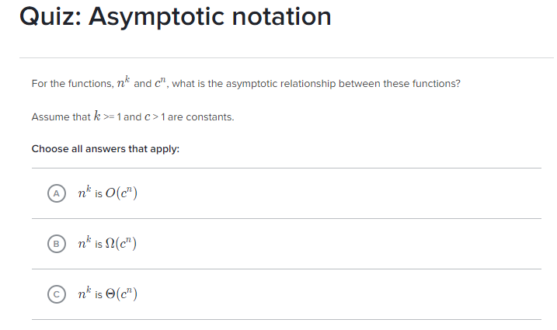
Source: https://www.khanacademy.org/computing/computer-science/algorithms/asymptotic-notation/e/quiz--asymptotic-notation

Slide 53
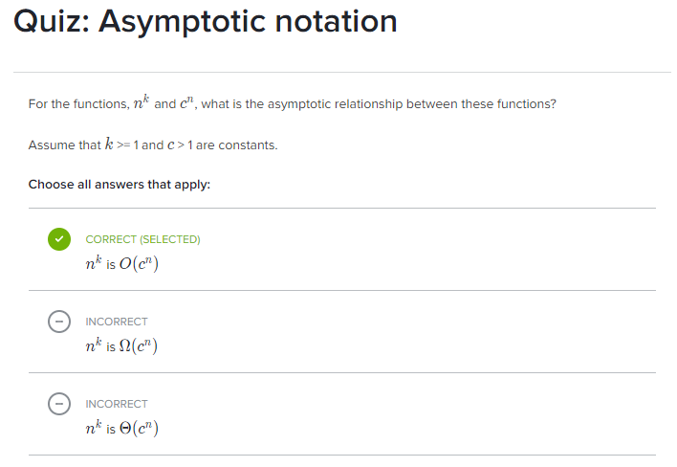

Slide 54
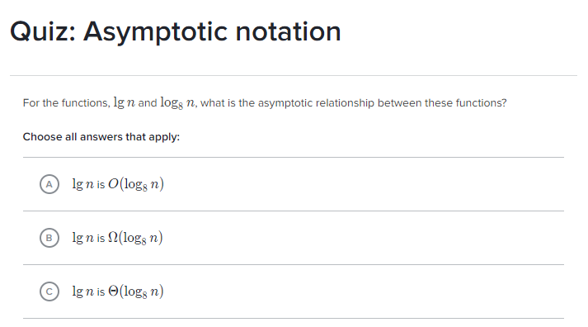

Slide 55
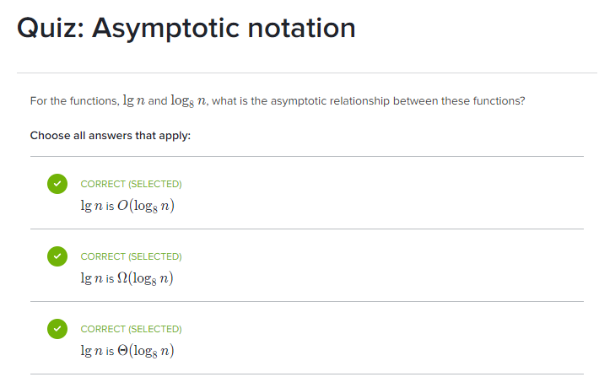

Slide 56
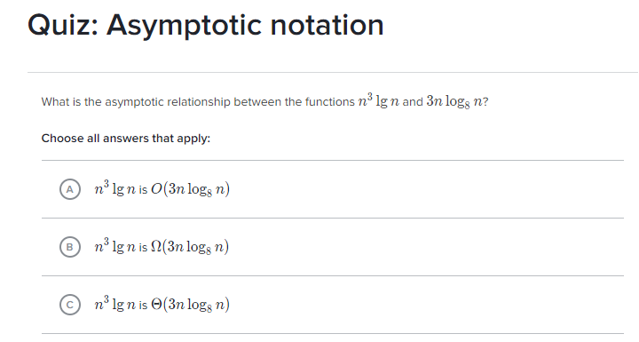

Slide 57
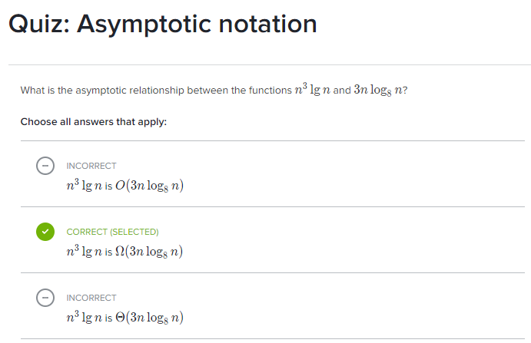

Slide 58
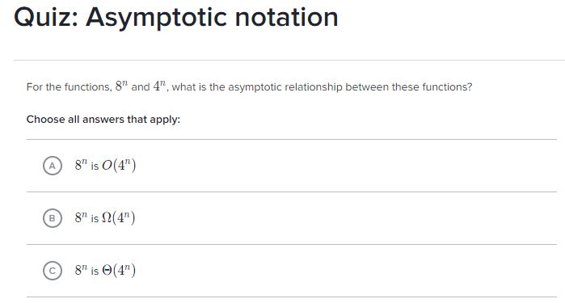

Slide 59
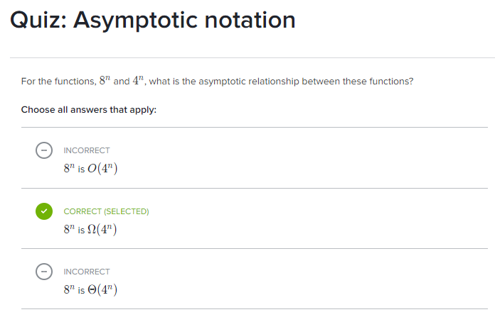

Slide 60

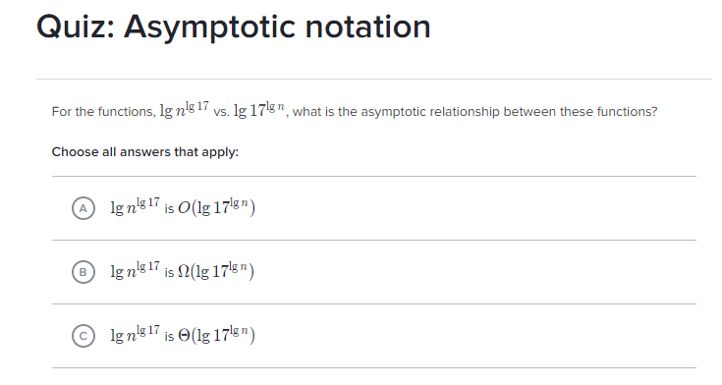

Slide 61
